Slide 1
The FQHE on cylinder using DMRG

Slide 2
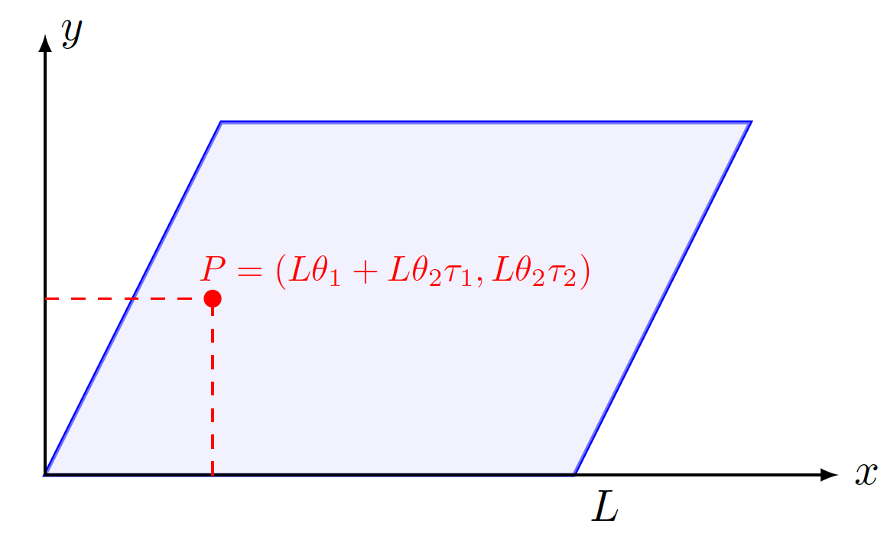
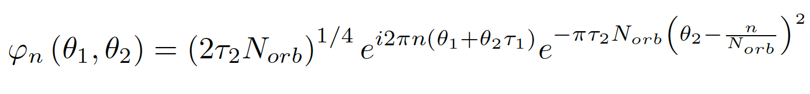
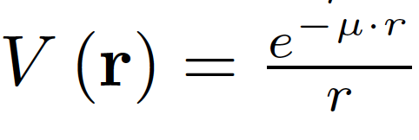
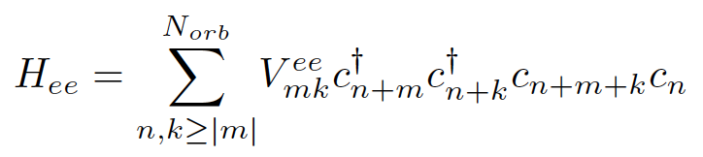
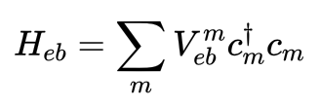
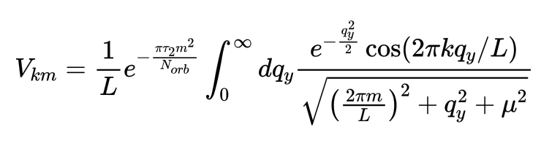
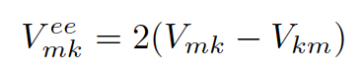
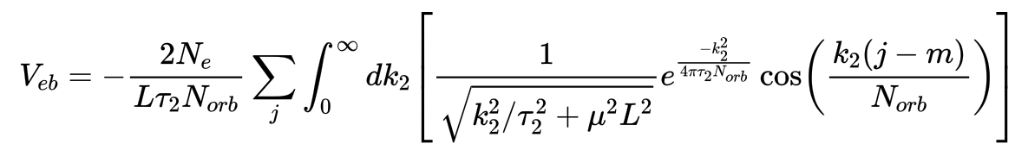
lowest LL wavefunction:
In second quantization, the Coulomb interaction between the electrons in the lowest LL is
Electron-electron interaction
Electron-background interaction

Slide 3
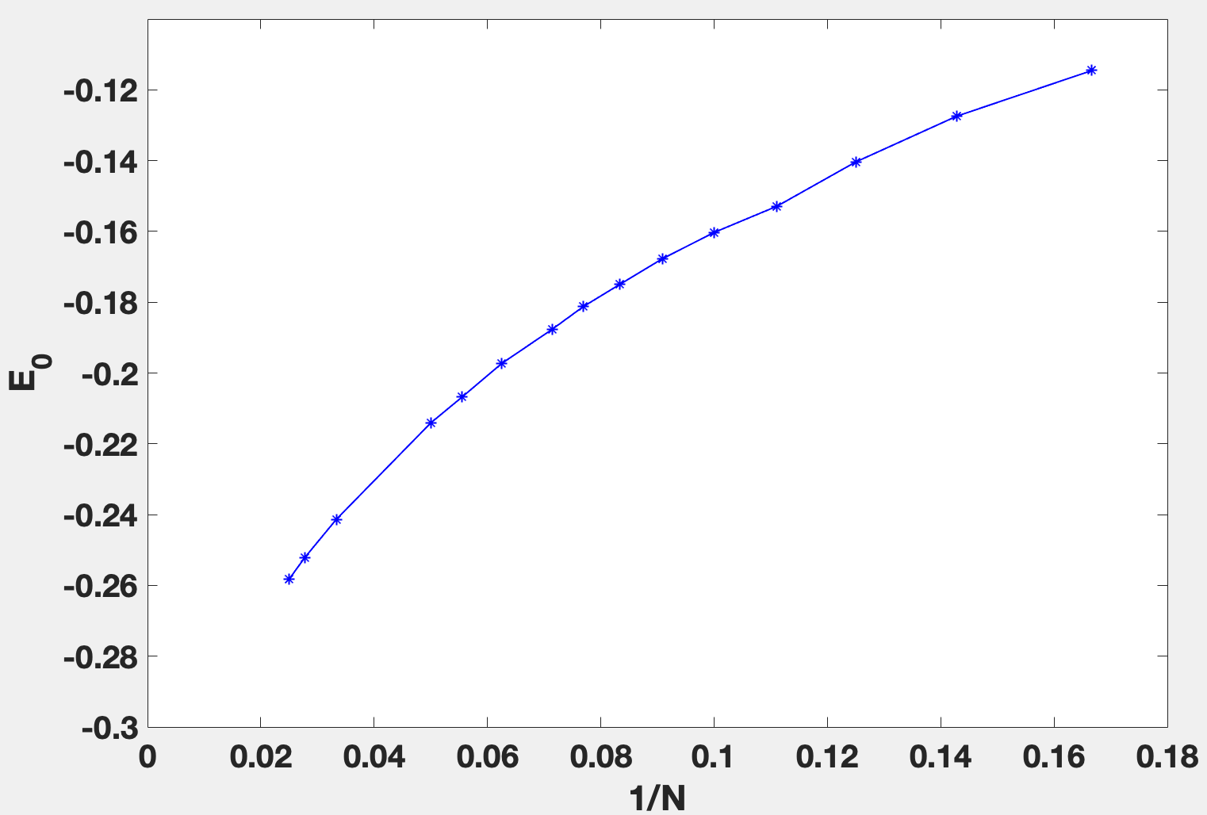
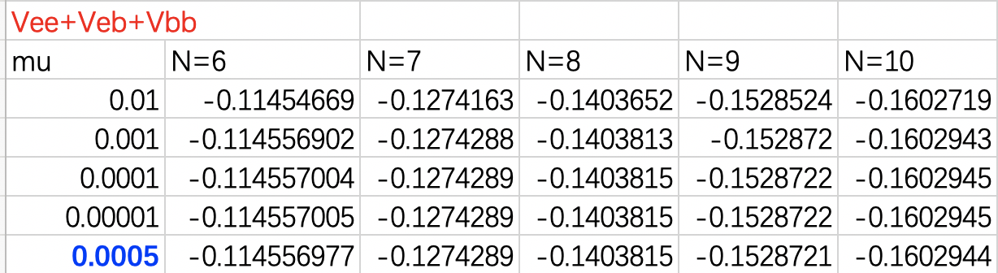
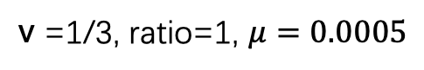
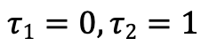
v =1/3, ratio=1, $μ=0.0005$
$$τ1=0,τ2=1$$
Ground energy=Vee+Veb+Vbb

Slide 4
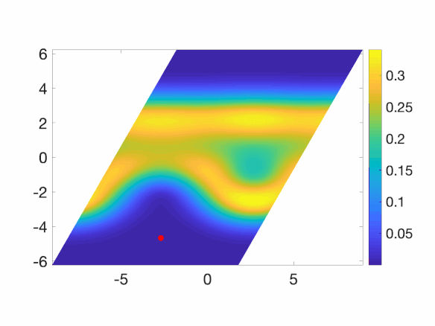
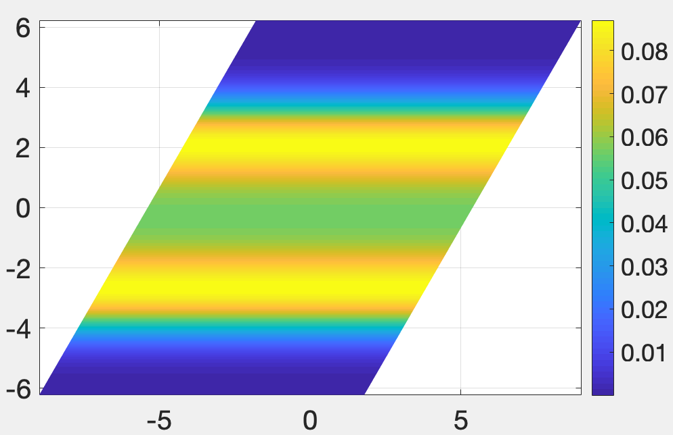
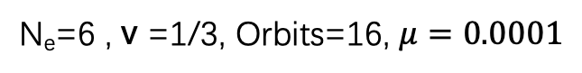
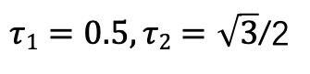
N_{e}=6 , v =1/3, Orbits=16, $μ=0.0001$
parallelogram
Pair correlation function
$τ1=0.5,τ2=\sqrt{3}$/2
Electron density

Slide 5
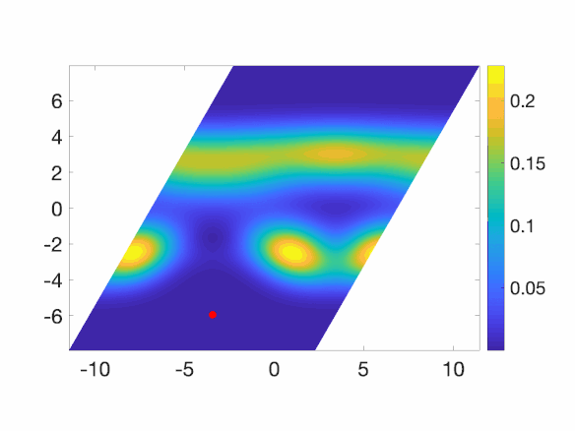
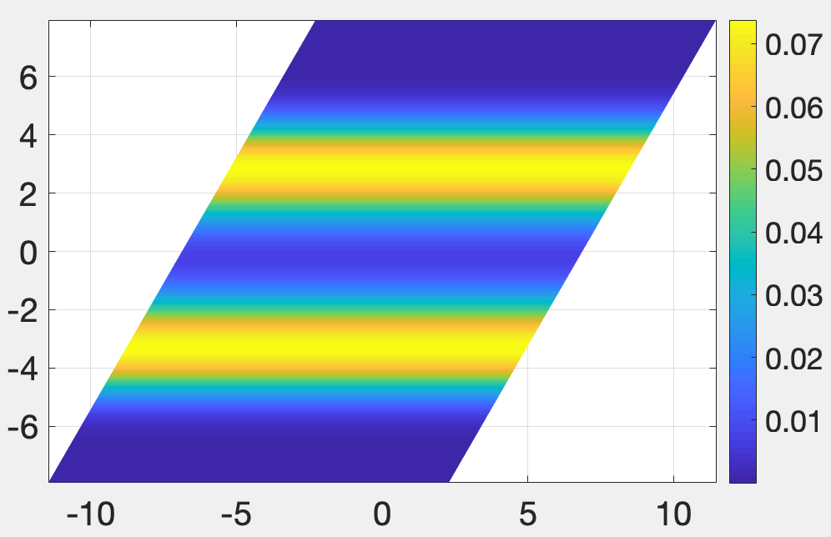
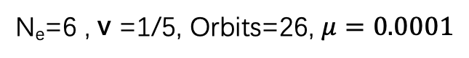
N_{e}=6 , v =1/5, Orbits=26, $μ=0.0001$
parallelogram
Pair correlation function
Electron density

Slide 6
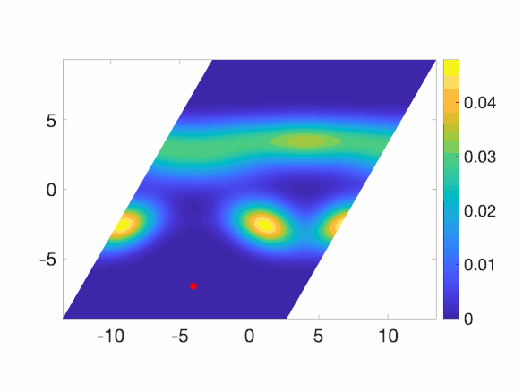
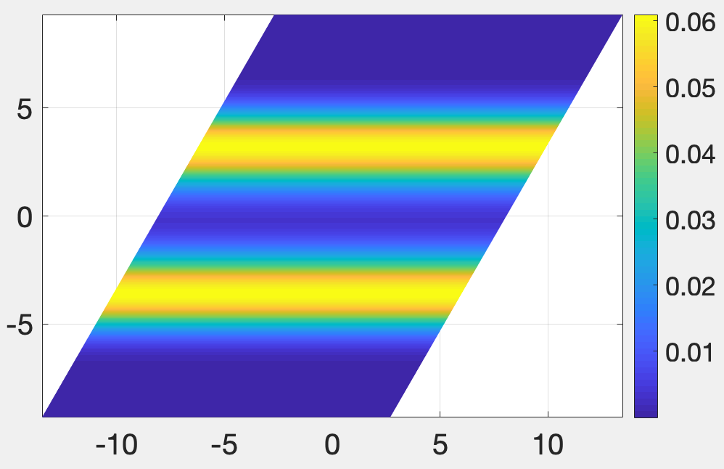
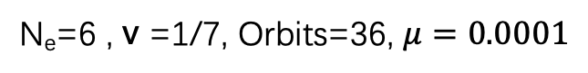
N_{e}=6 , v =1/7, Orbits=36, $μ=0.0001$
parallelogram
Pair correlation function
Electron density

Slide 7
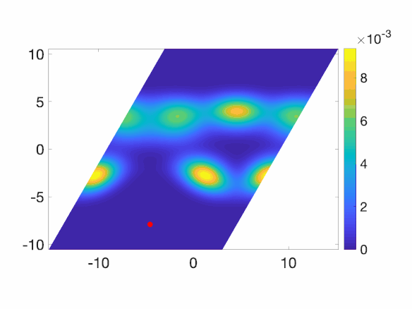
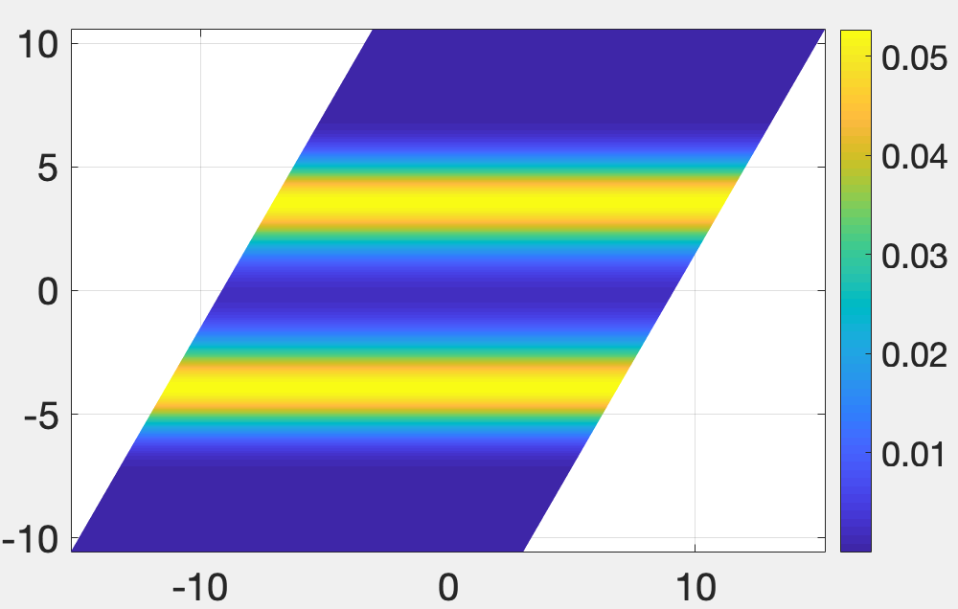
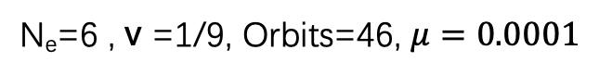
N_{e}=6 , v =1/9, Orbits=46, $μ=0.0001$
parallelogram
Pair correlation function
Electron density

Slide 8
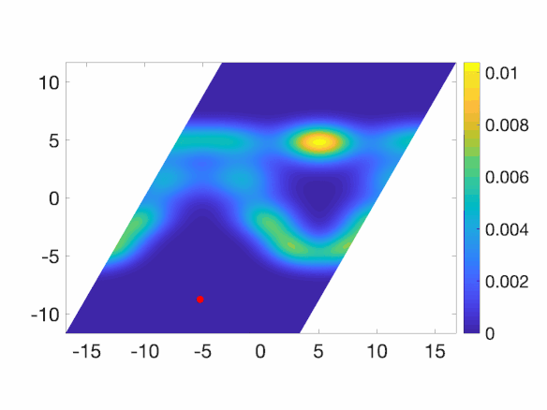
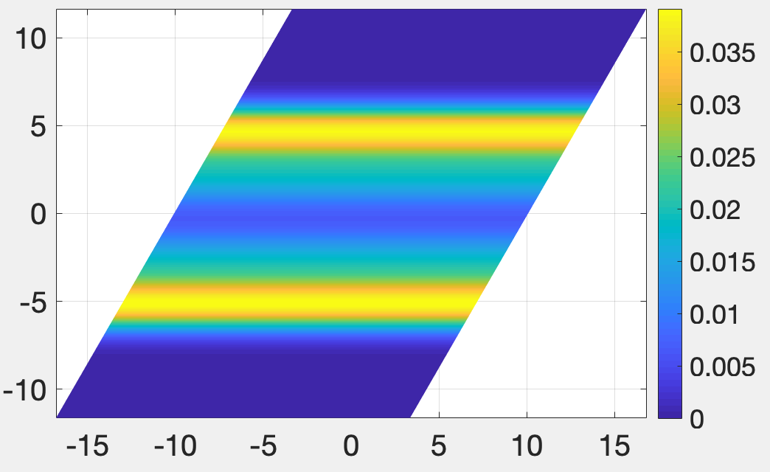
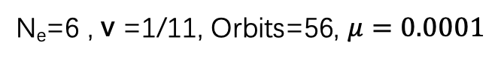
N_{e}=6 , v =1/11, Orbits=56, $μ=0.0001$
parallelogram
Pair correlation function
Electron density

Slide 9
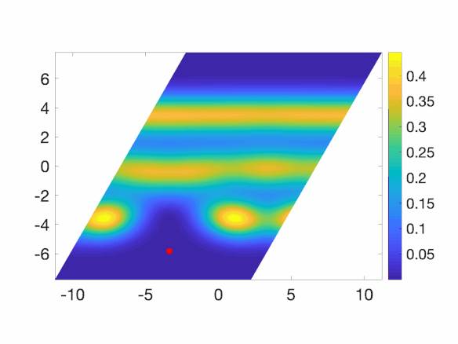
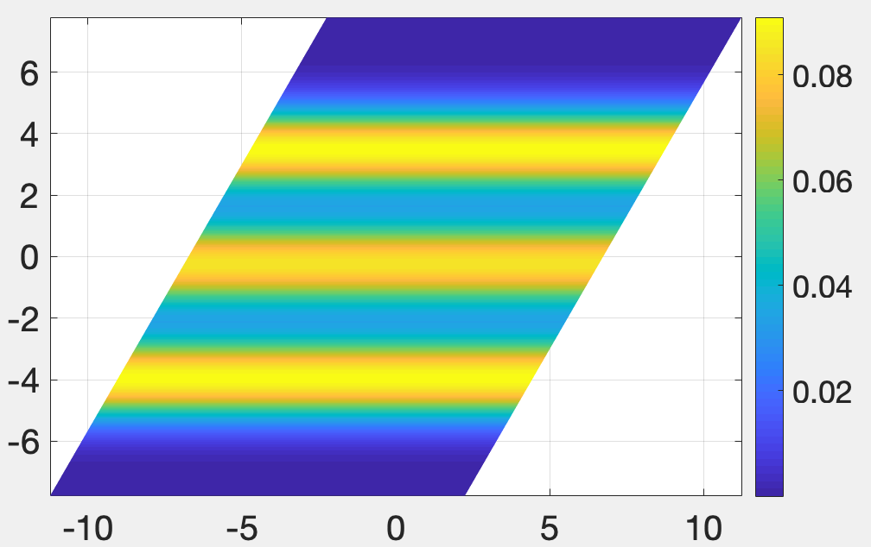
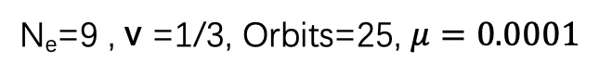
N_{e}=9 , v =1/3, Orbits=25, $μ=0.0001$
parallelogram
Pair correlation function
Electron density

Slide 10
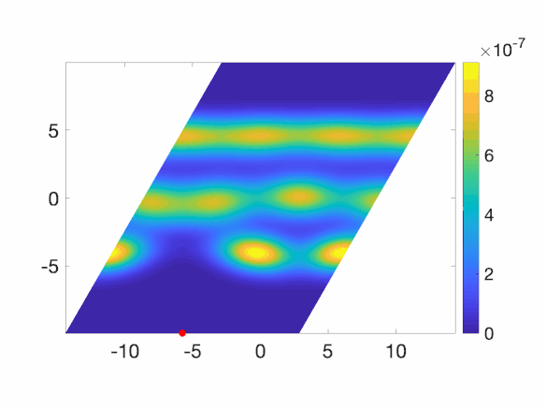
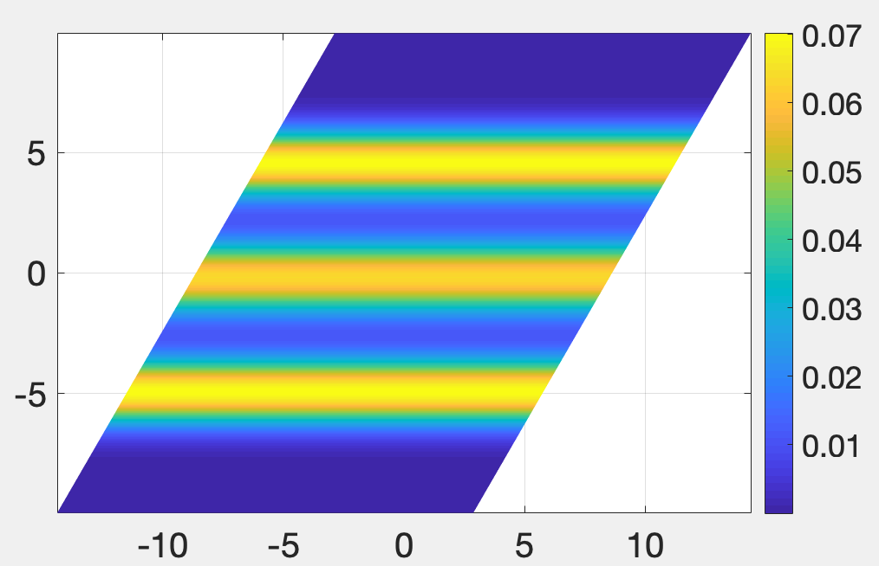
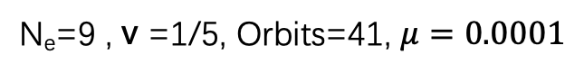
N_{e}=9 , v =1/5, Orbits=41, $μ=0.0001$
parallelogram
Pair correlation function
Electron density

Slide 11
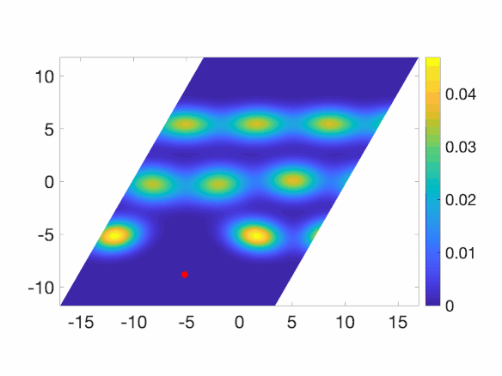
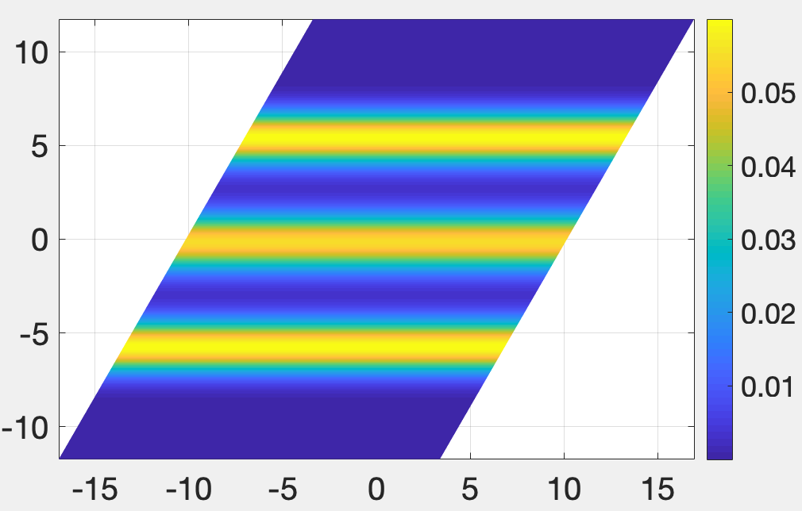
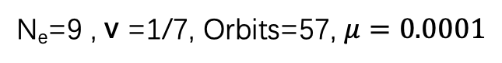
N_{e}=9 , v =1/7, Orbits=57, $μ=0.0001$
parallelogram
Pair correlation function
Electron density

Slide 12
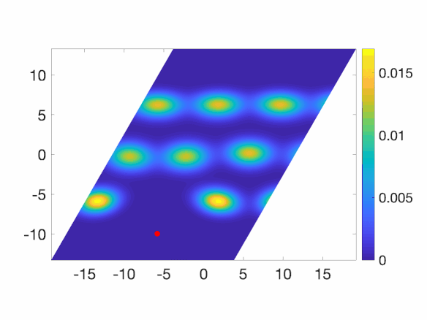
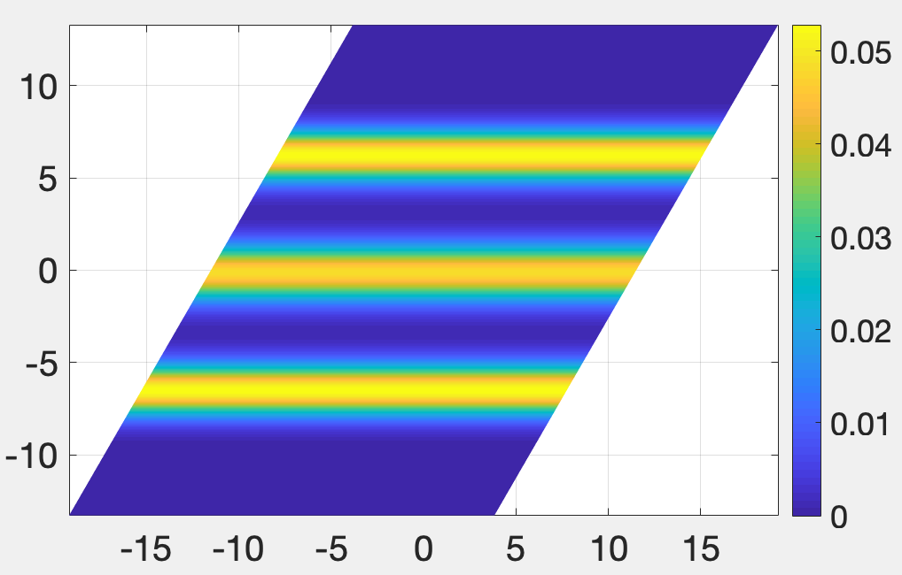
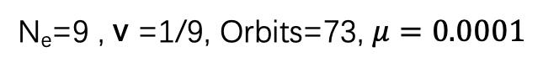
N_{e}=9 , v =1/9, Orbits=73, $μ=0.0001$
parallelogram
Pair correlation function
Electron density

Slide 13
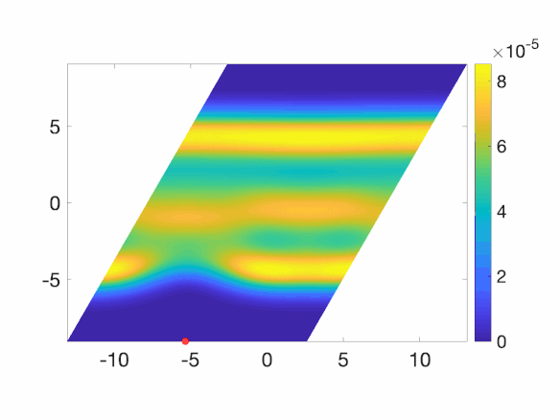
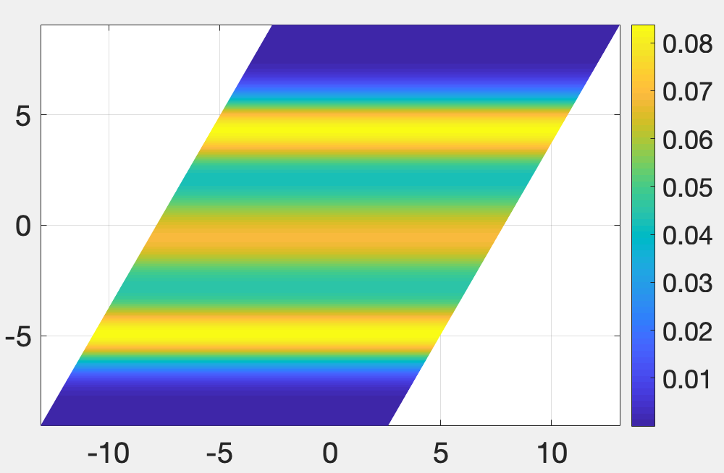
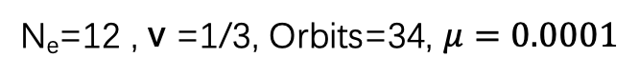
N_{e}=12 , v =1/3, Orbits=34, $μ=0.0001$
parallelogram
Pair correlation function
Electron density

Slide 14
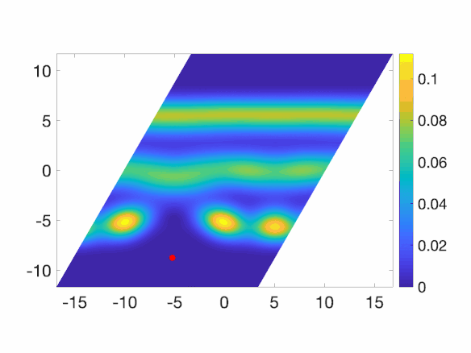
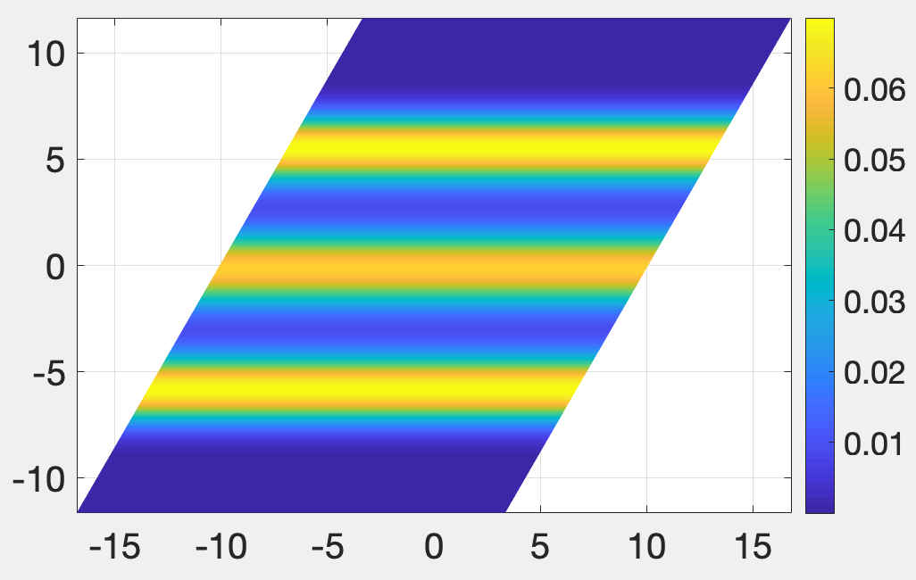
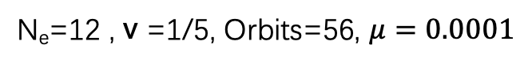
N_{e}=12 , v =1/5, Orbits=56, $μ=0.0001$
parallelogram
Pair correlation function
Electron density

Slide 15

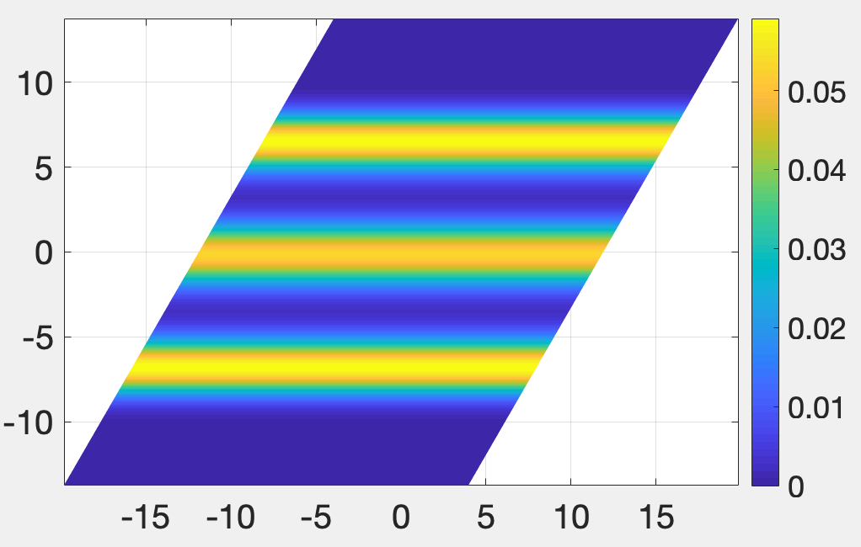
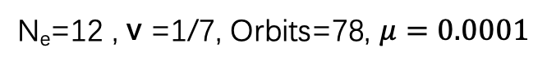
N_{e}=12 , v =1/7, Orbits=78, $μ=0.0001$
parallelogram
Pair correlation function
Electron density

Slide 16
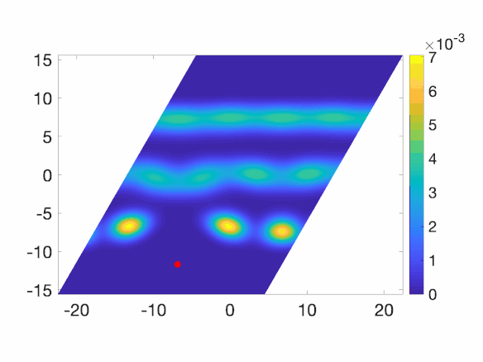
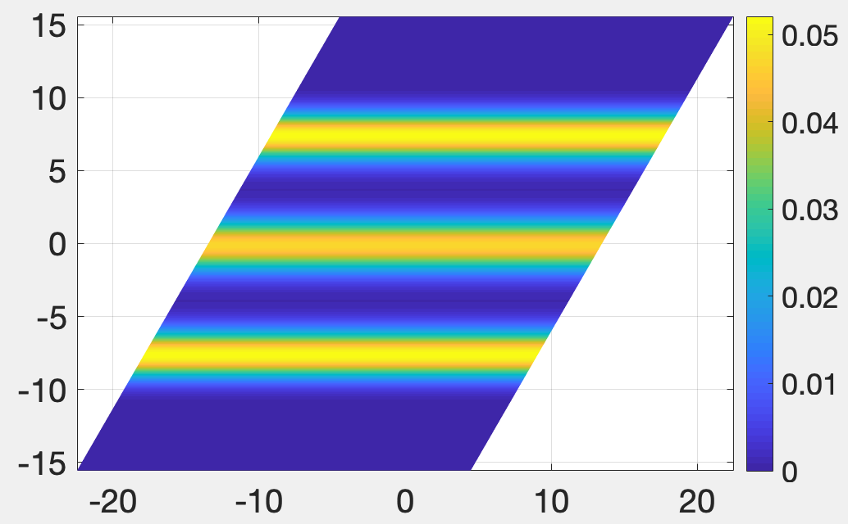

N_{e}=12 , v =1/9, Orbits=100, $μ=0.0001$
parallelogram
Pair correlation function
Electron density

